Slide 1
CLAfICLe: Cross Lingual Adaptation for In-Context Learning
Behind the scenes
Giulio Starace

Slide 2


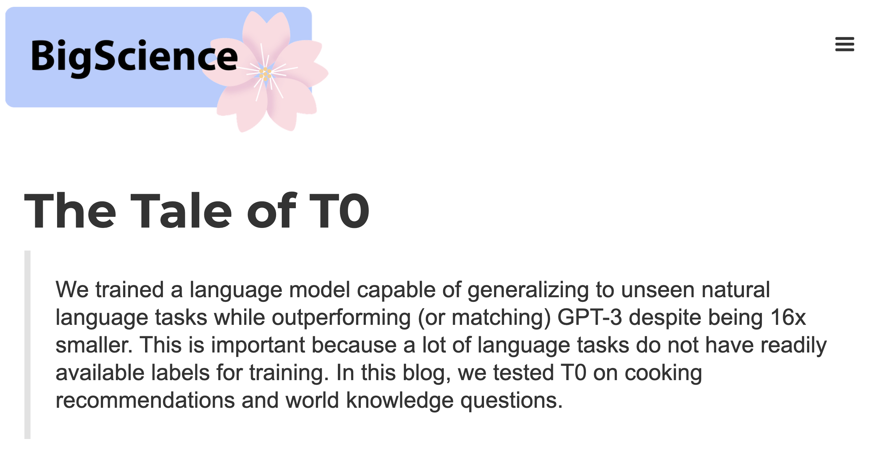



Context

Slide 3
Goal
Adapt T0 to work with Dutch and/or French inputs and outputs.

Slide 4
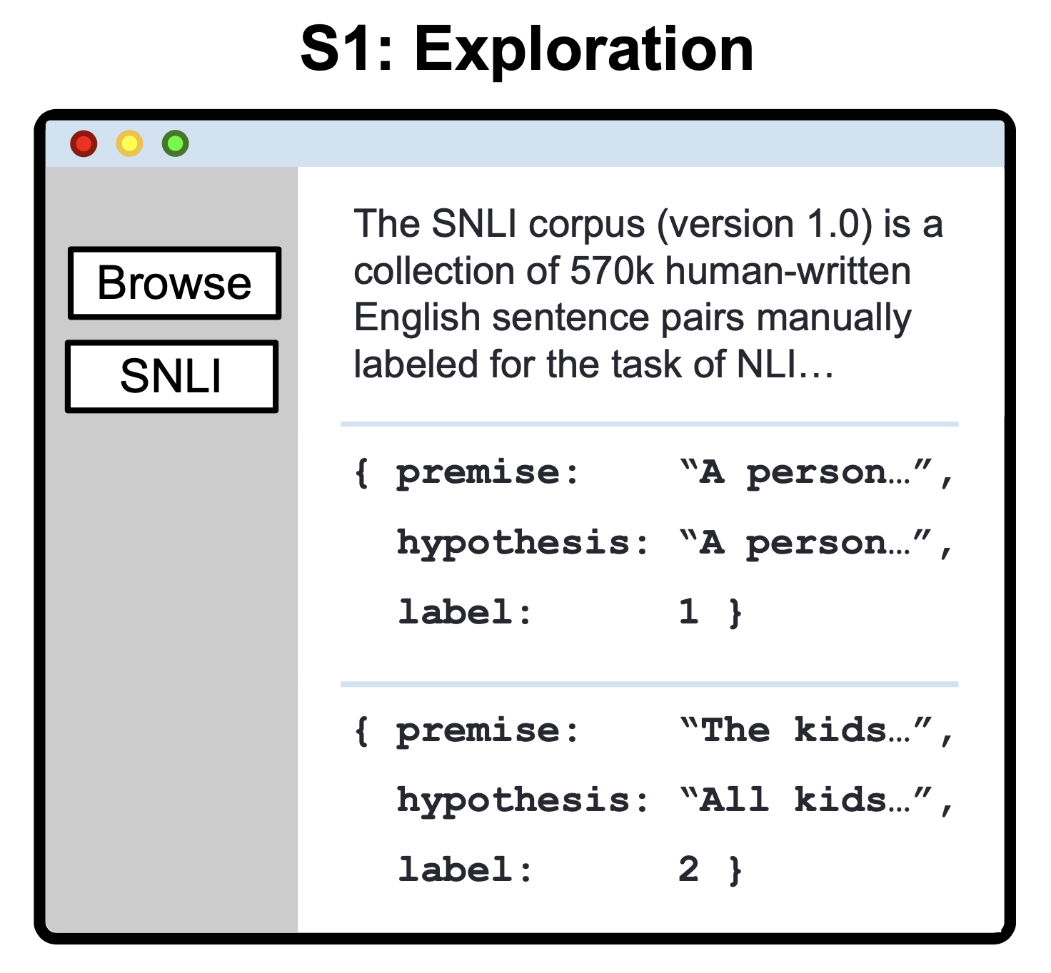
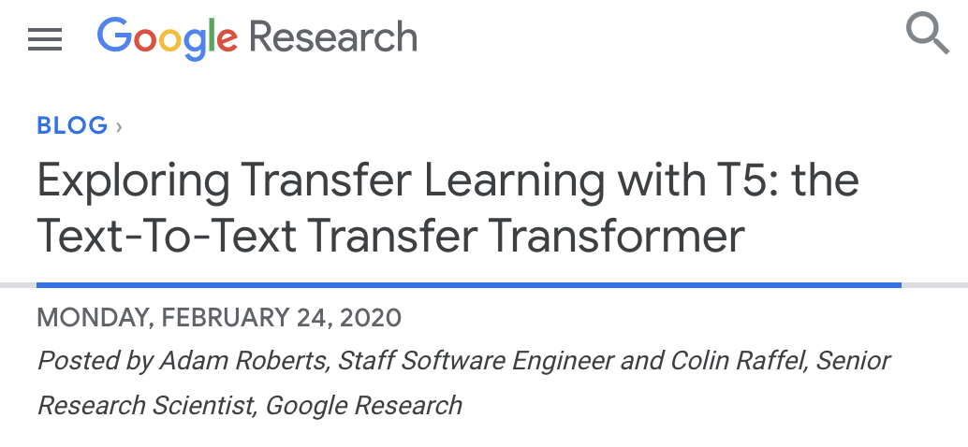
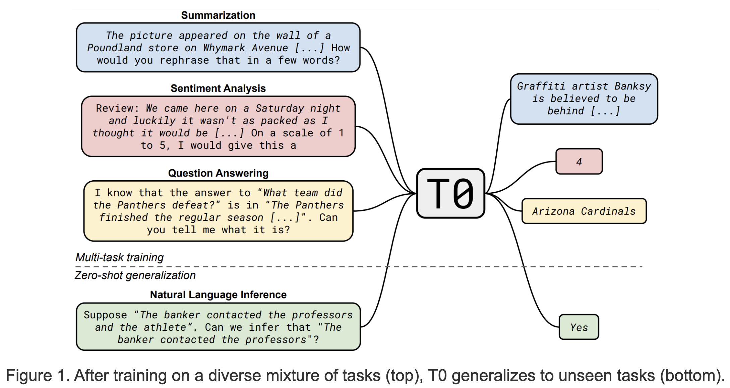
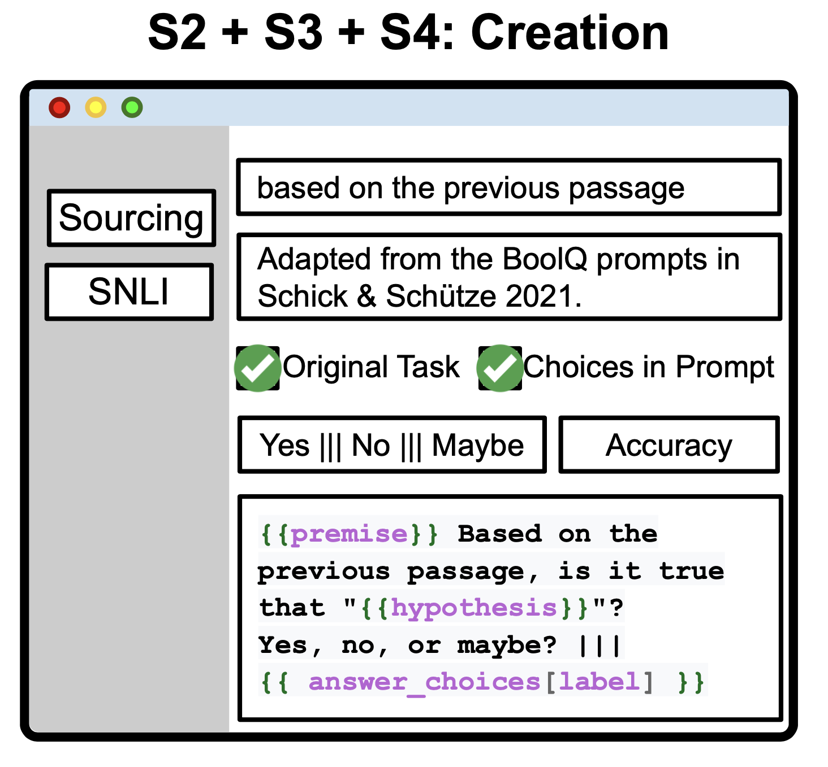
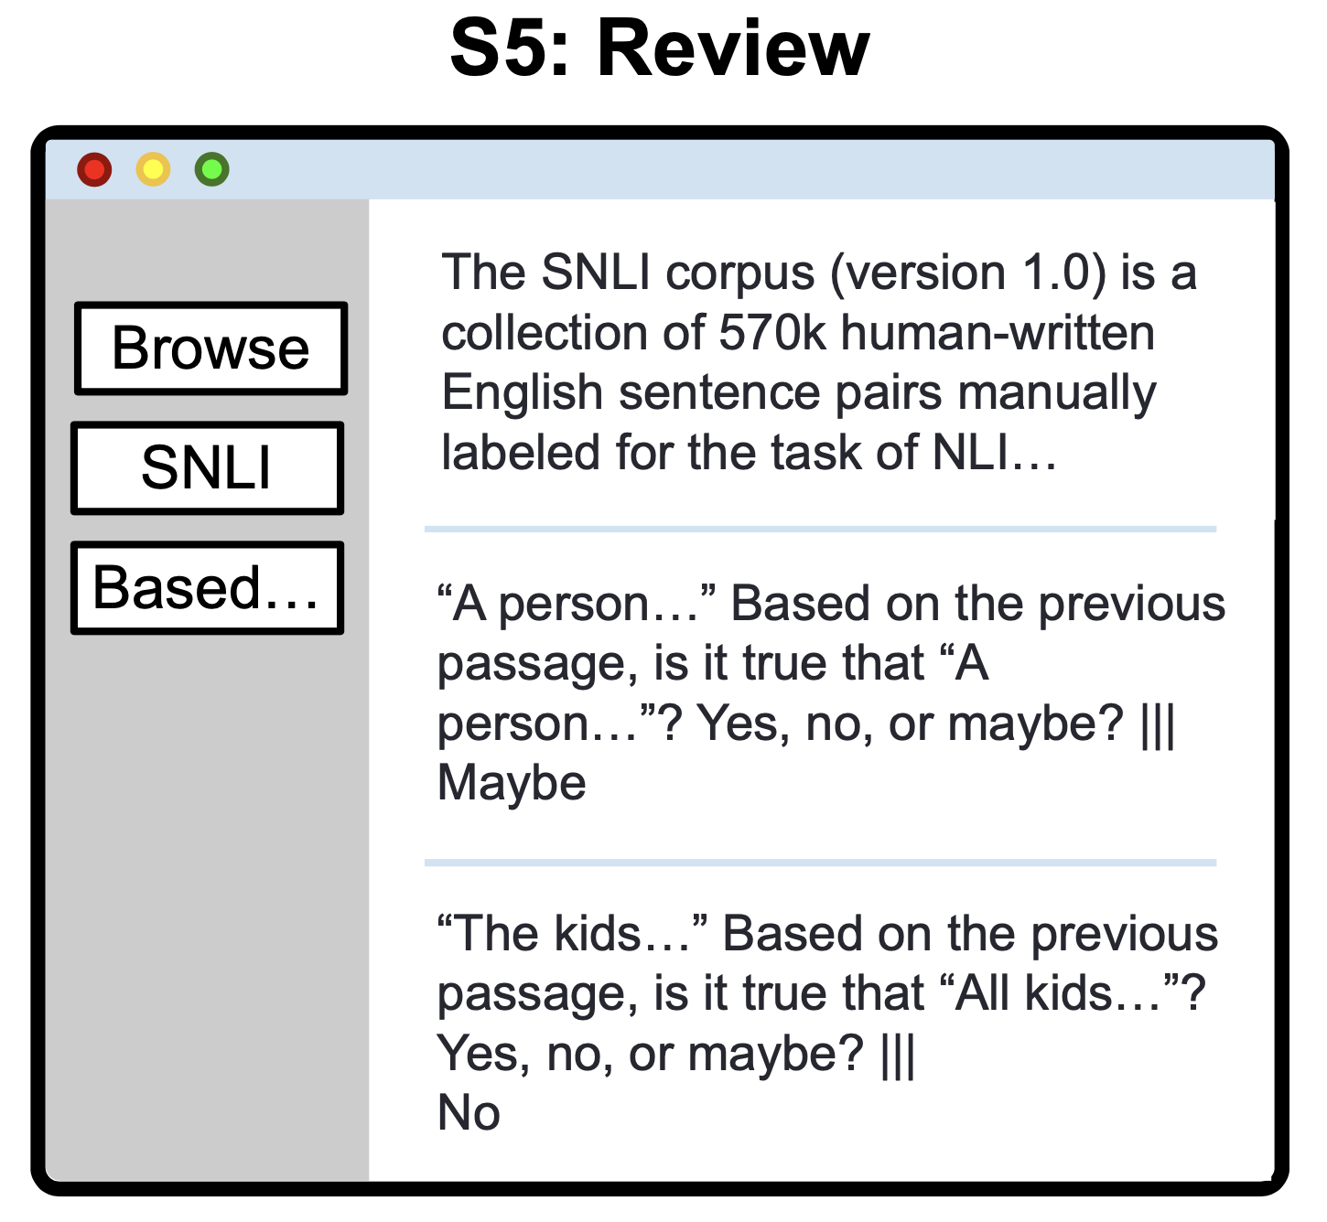
Context - T0 and PromptSource
Raffel, C. et al. Exploring the Limits of Transfer Learning with a Unified Text-to-Text Transformer. Journal of Machine Learning Research 21, 1–67 (2020).
Wei, J. et al. Finetuned Language Models are Zero-Shot Learners. in (2021).
Bach, S. H. et al. PromptSource: An Integrated Development Environment and Repository for Natural Language Prompts. arXiv:2202.01279 [cs] (2022).

Slide 5
Requirements for evaluation
Hardware for 3B-param model (full-size is 11B)
Dutch and French Datasets
Templates for prompting in Dutch and French, for evaluation

Slide 6
Hardware requirements
We’ll come back to this :)

Slide 7
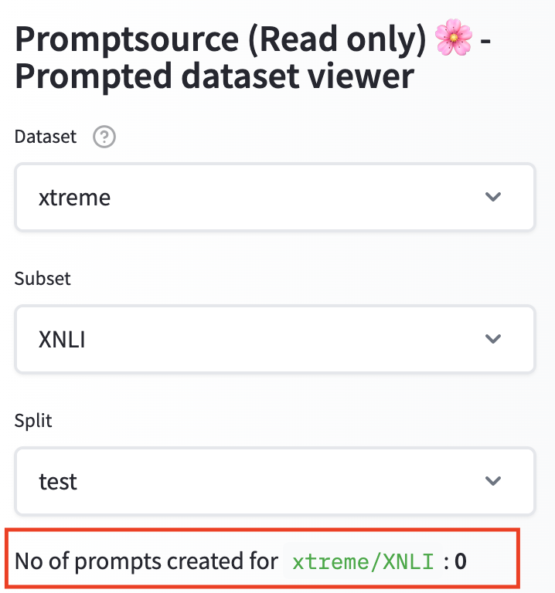
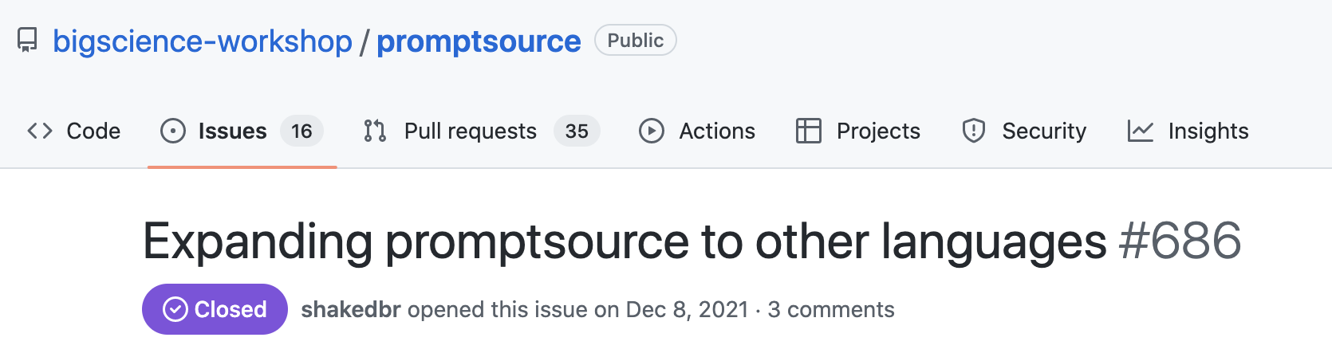
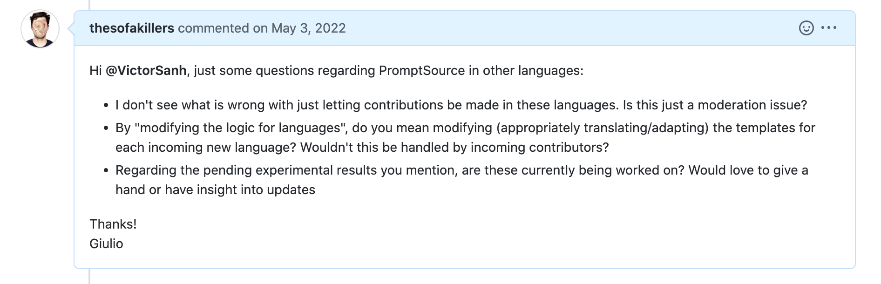
Data Requirements

Slide 8


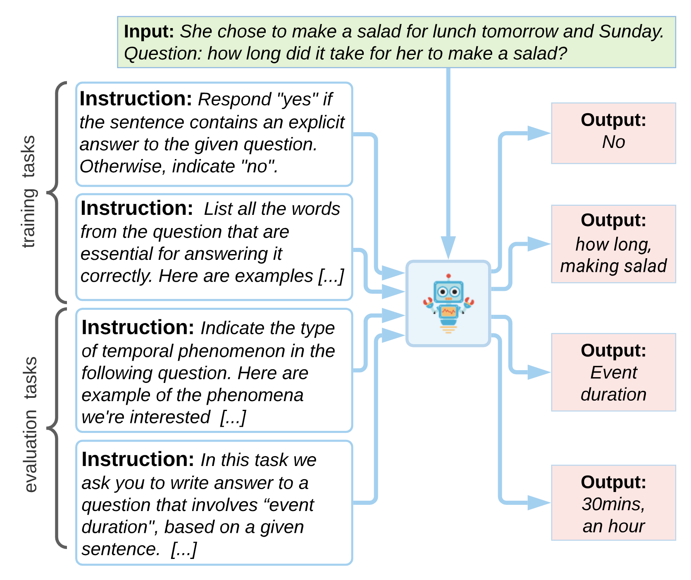
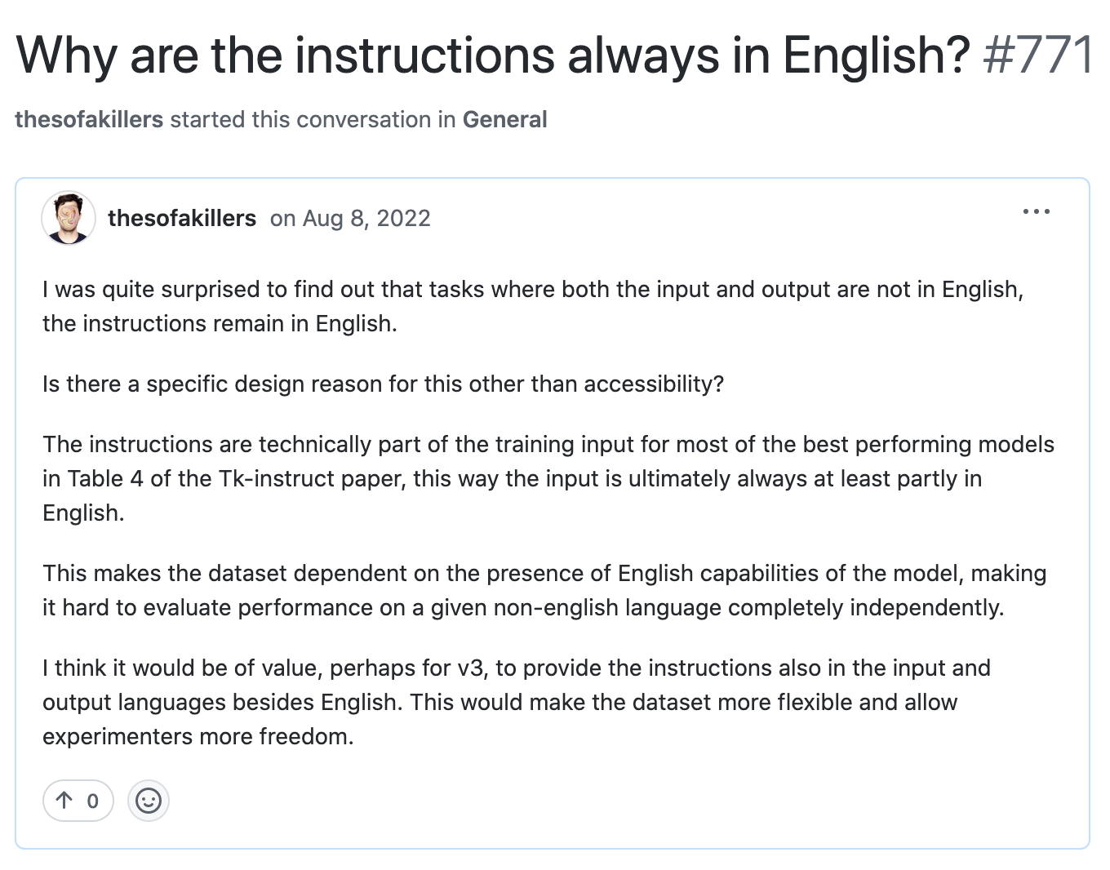
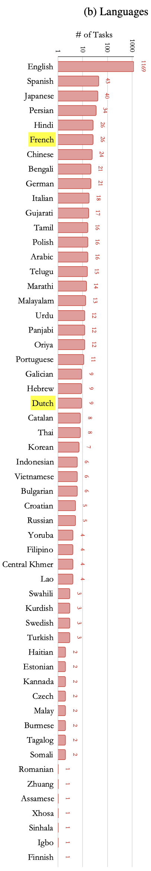
Data Requirements - Continued
Wang, Y. et al. Benchmarking Generalization via In-Context Instructions on 1,600+ Language Tasks. arXiv:2204.07705 [cs] (2022).

Slide 9
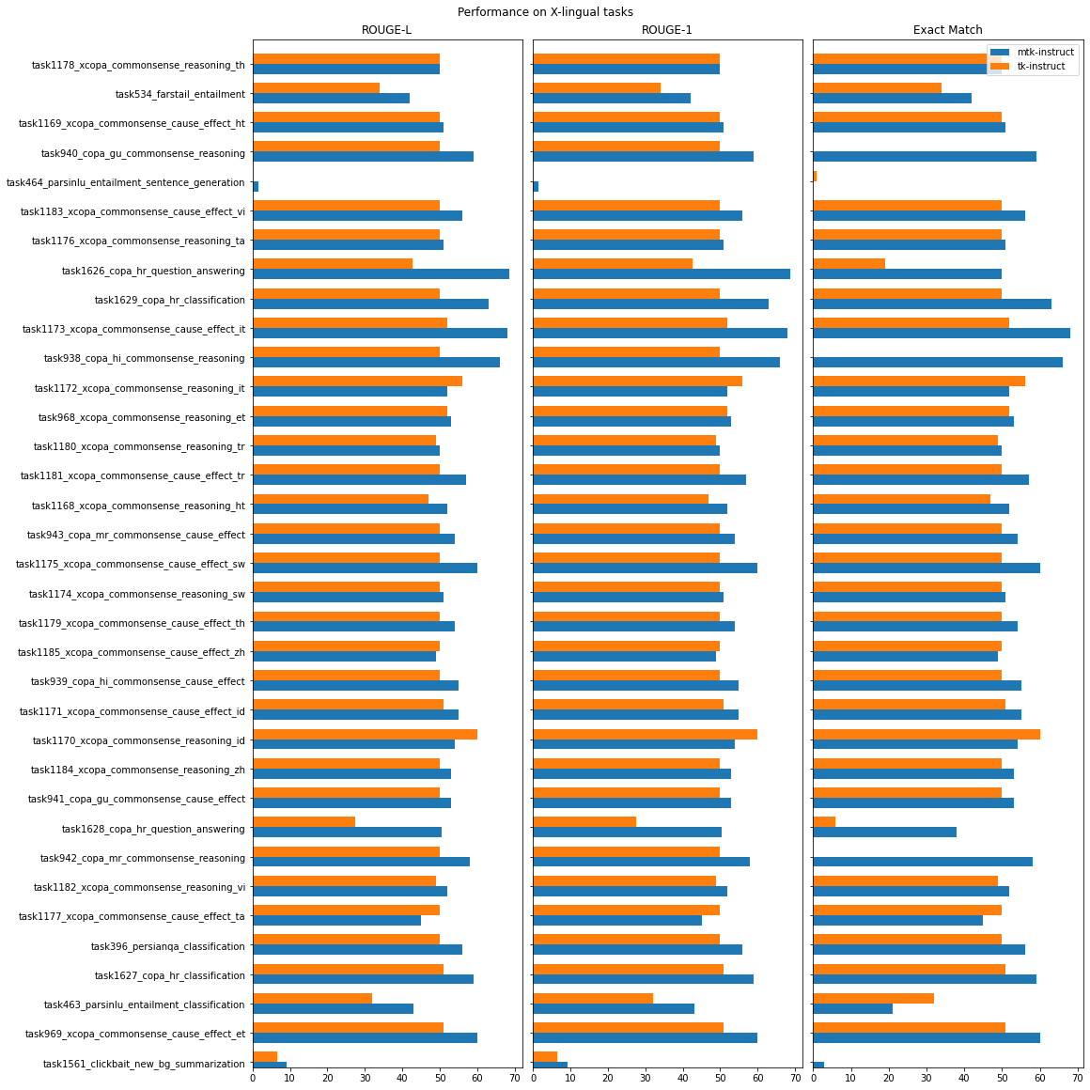
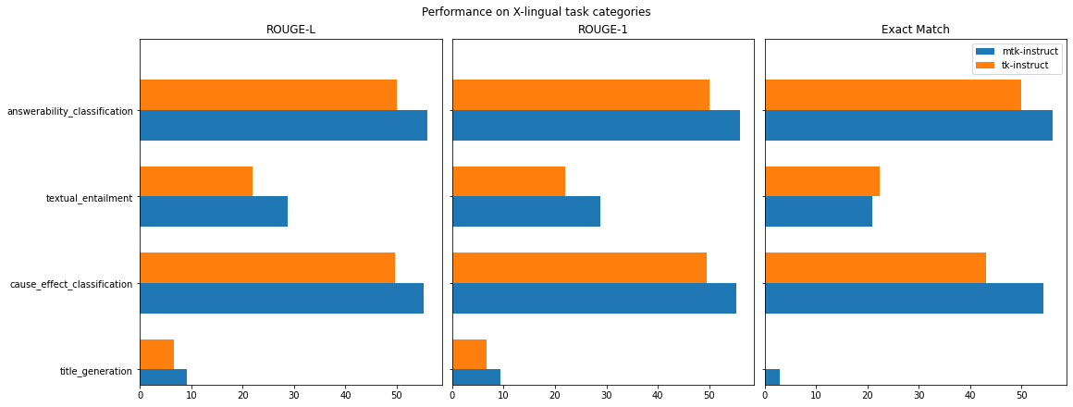

Brief Aside – Tk-instruct

Slide 10
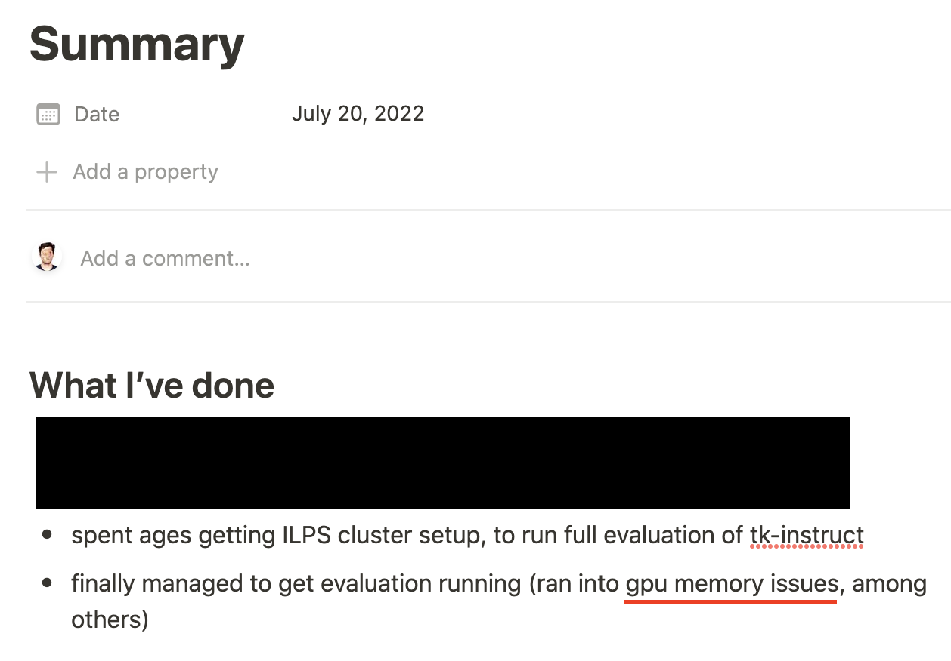
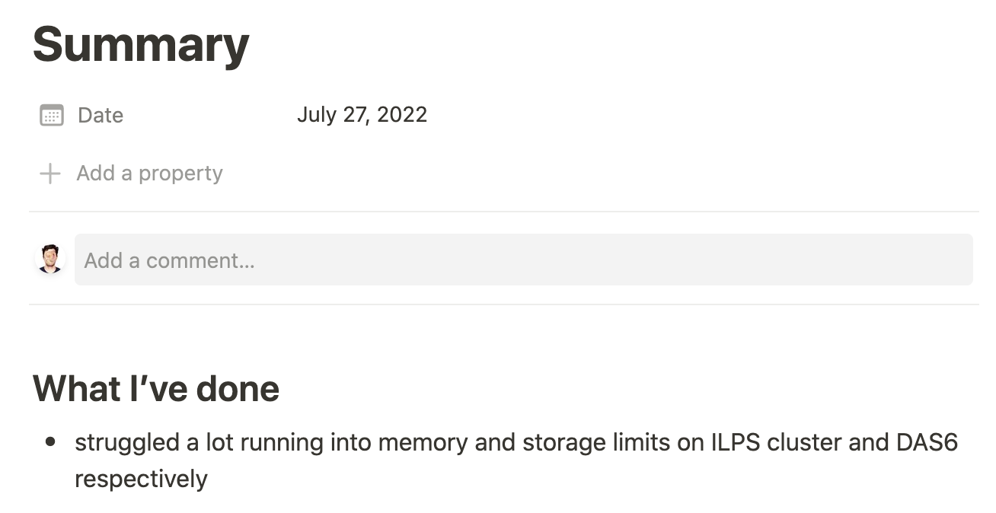
Hardware requirements

Slide 11
Problems
Models too big
No real prompt/instruction datasets outside of english

Slide 12
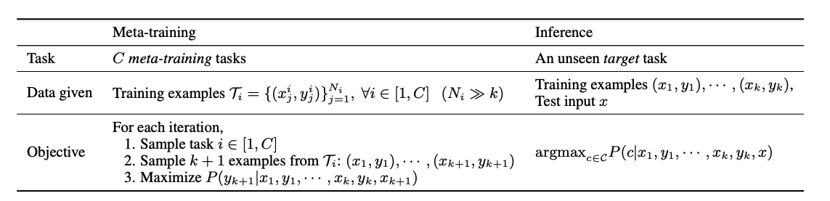
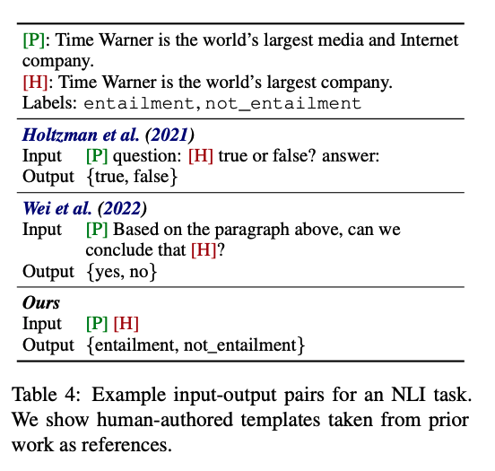
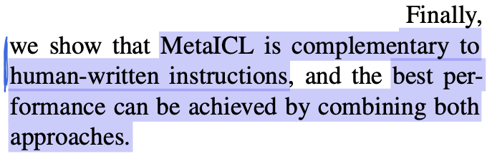
Solution - MetaICL: Learning to Learn In Context
Hardware requirements:
Max model size: 774M params (GPT2-large)
Dataset requirements:
No need for instructions/prompt templates
input/output pairs simply concatenated
Task requirements:
Multi-task generalisation via in-context learning (ICL)
Compatible with Instructions/Prompts
Min, S., Lewis, M., Zettlemoyer, L. & Hajishirzi, H. MetaICL: Learning to Learn In Context. in Proceedings of the 2022 Conference of the North American Chapter of the Association for Computational Linguistics: Human Language Technologies 2791–2809 (Association for Computational Linguistics, 2022). doi:10.18653/v1/2022.naacl-main.201.

Slide 13
Next Step
Find downstream tasks in French and Dutch for evaluation

Slide 14
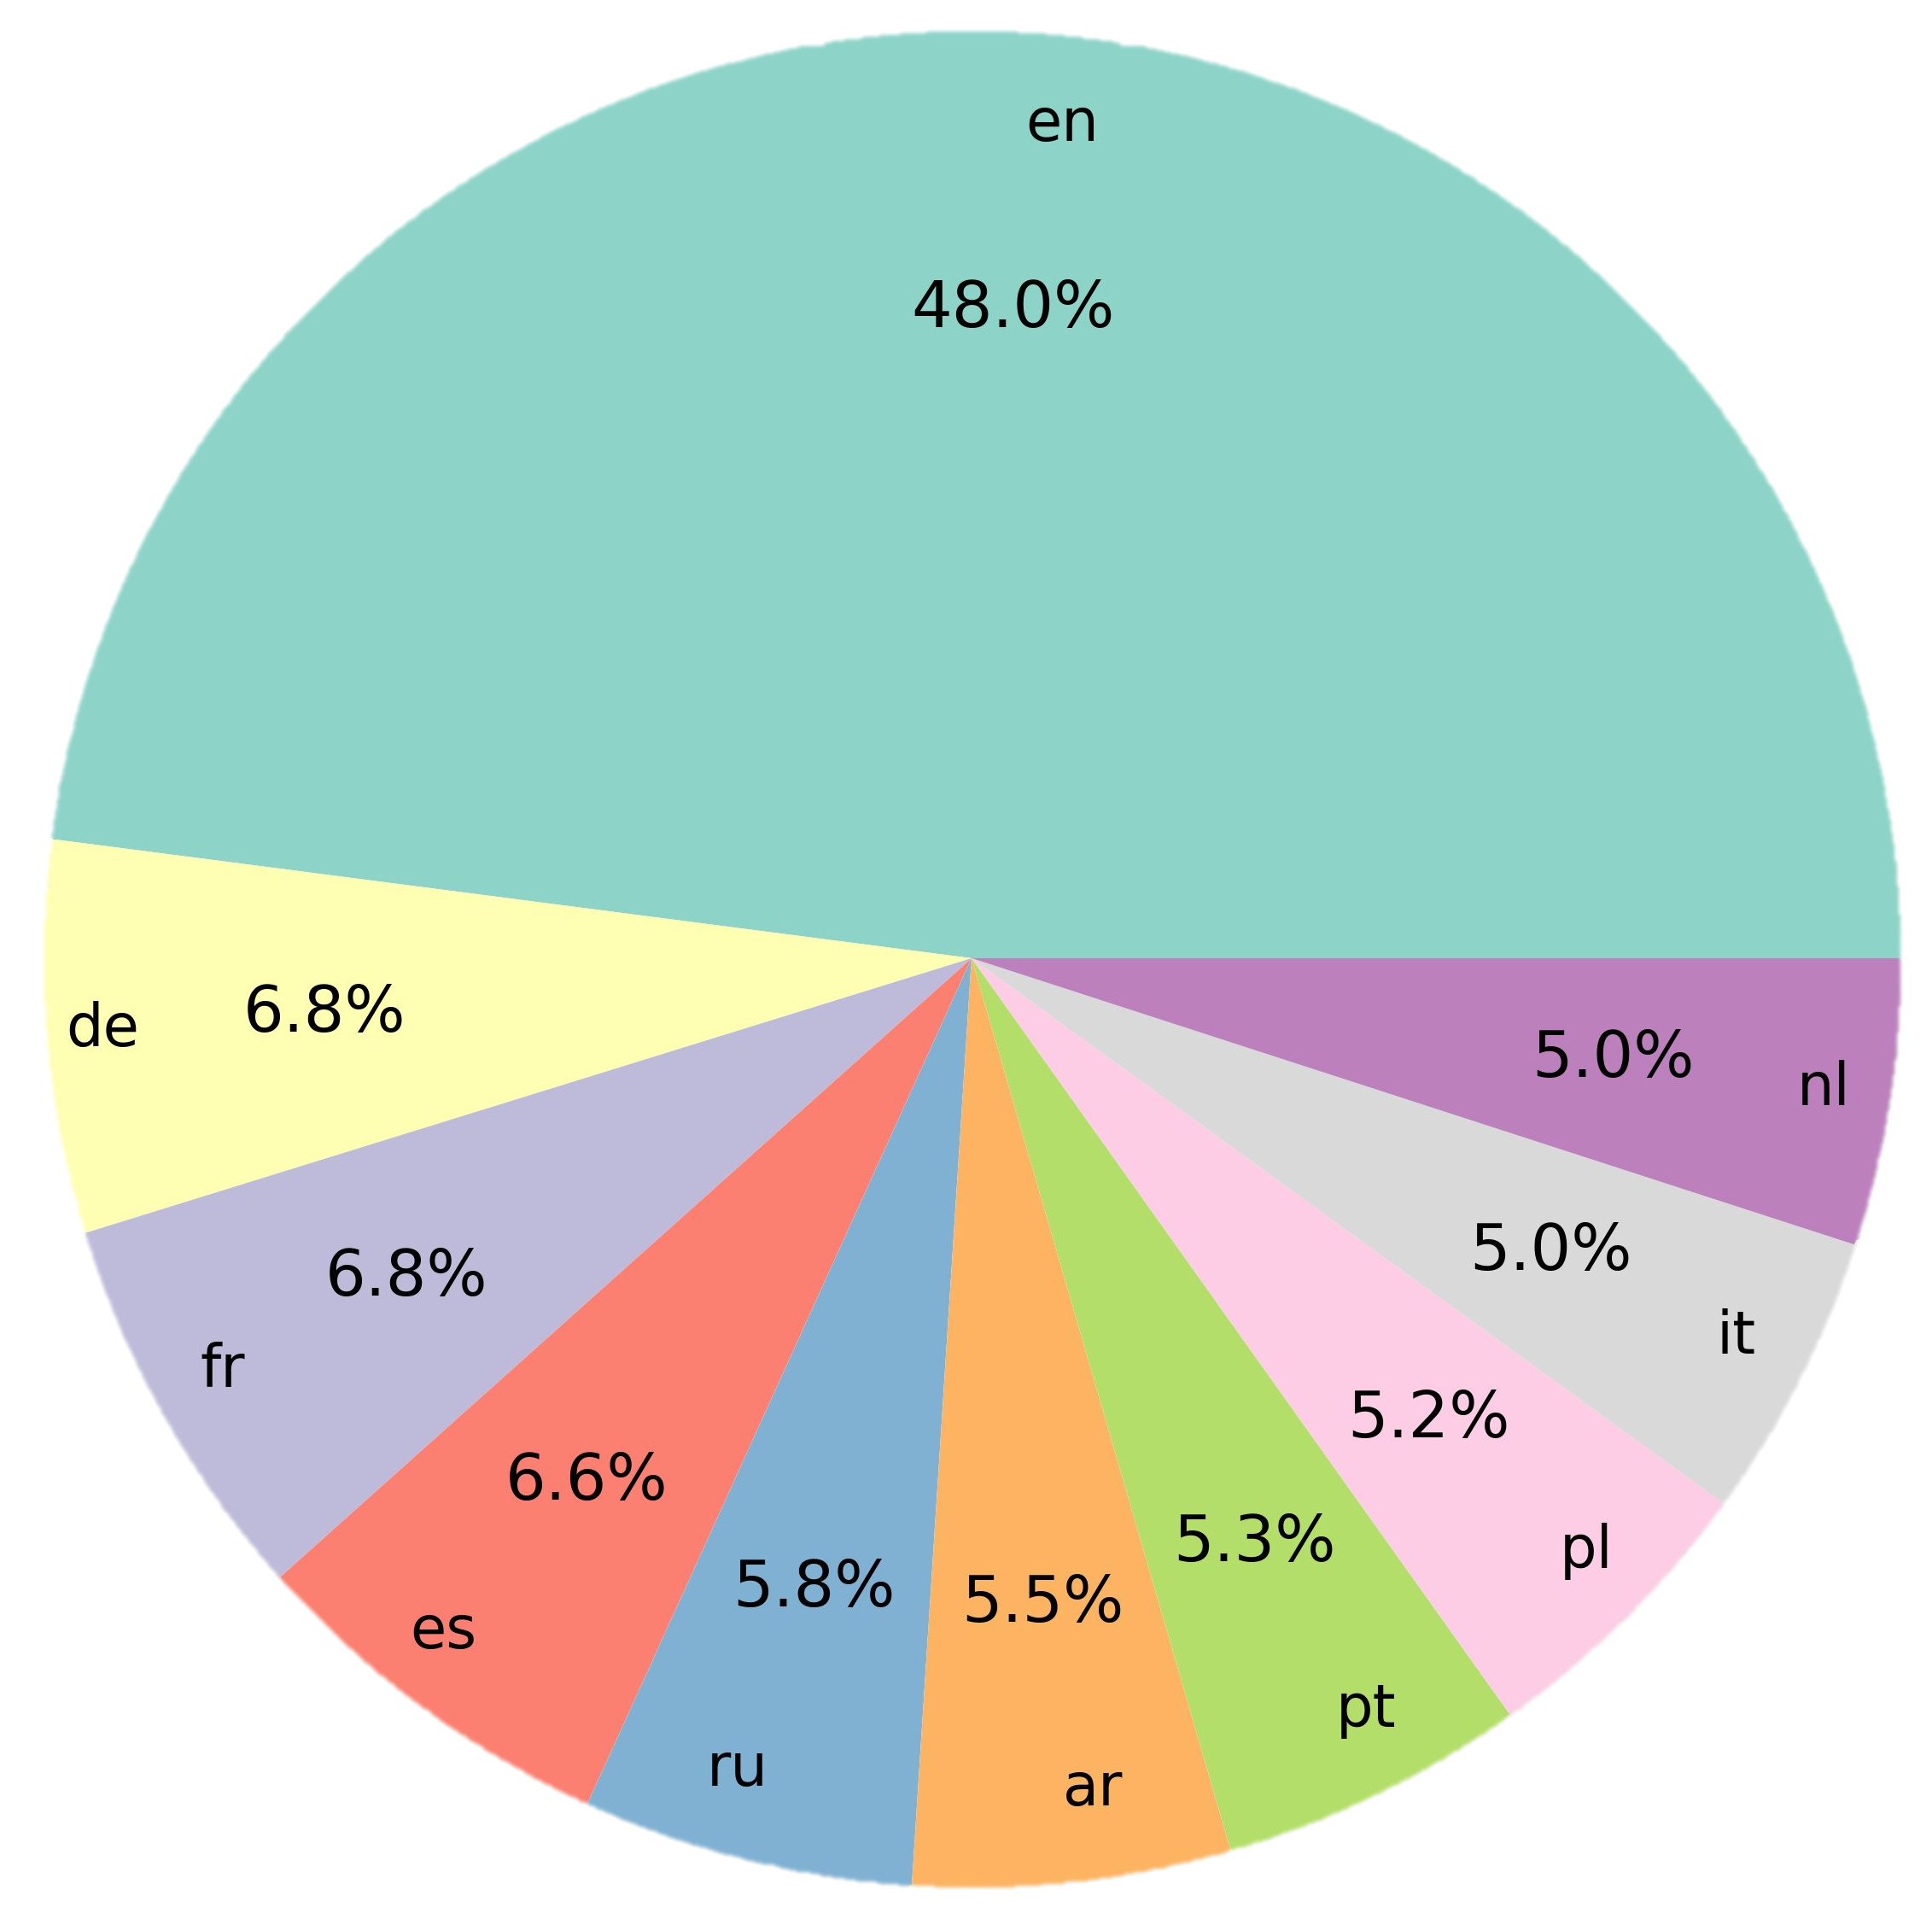
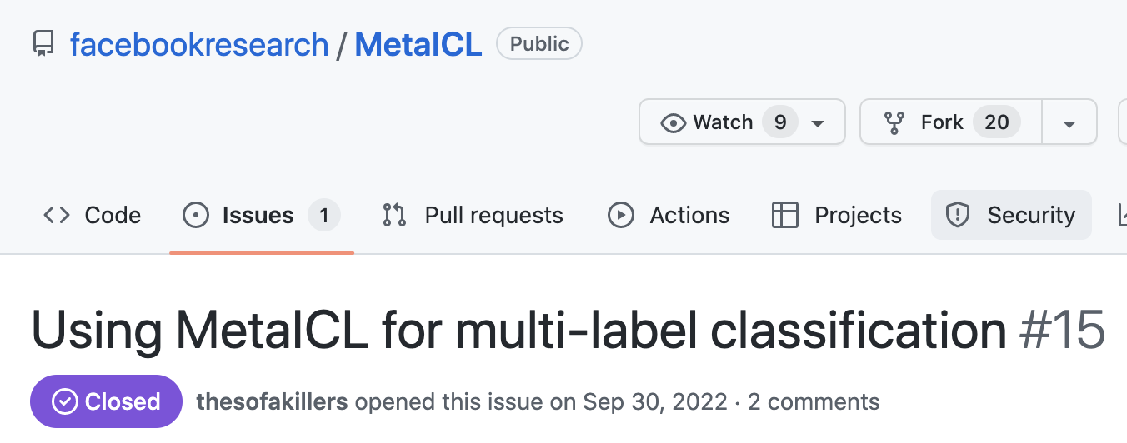
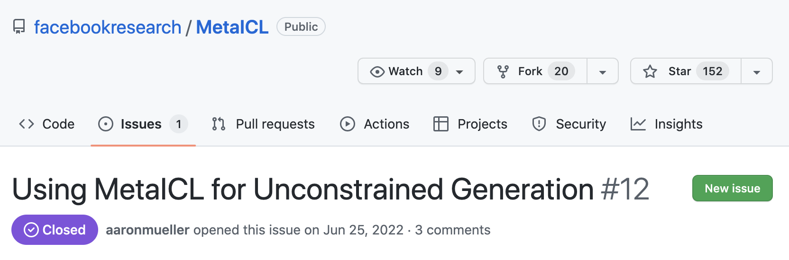
More Dataset considerations
MetaICL can only handle multi-class, single-label tasks.
Want to use datasets that exist across all three of languages
Enable fairer comparison in language dimension

Slide 15
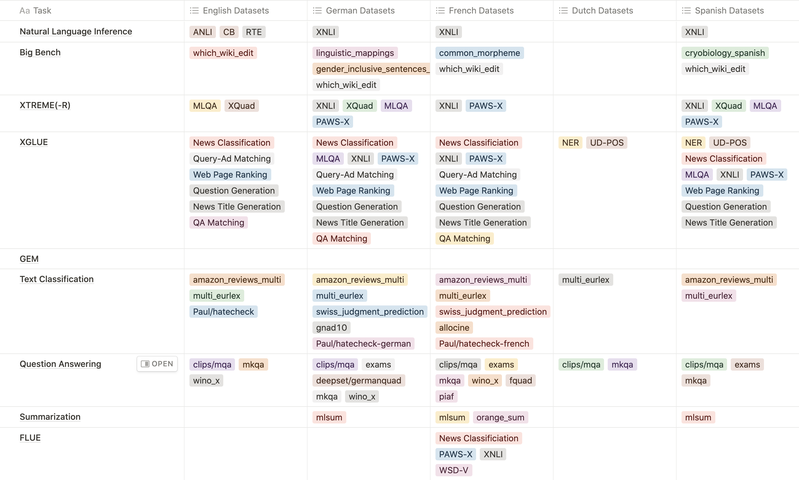
More Dataset considerations
French and German
lack of Dutch datasets

Slide 16
Recap
Using MetaICL (774M params) instead of T0 or Tk-instruct (11B params)
Adapting to French and German instead of French and Dutch
Ok, this is the setup – how are we actually going to tackle the adaptation task?

Slide 17
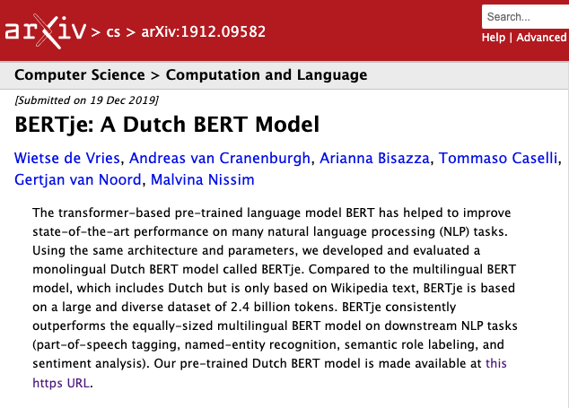
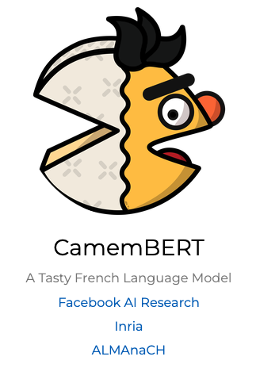
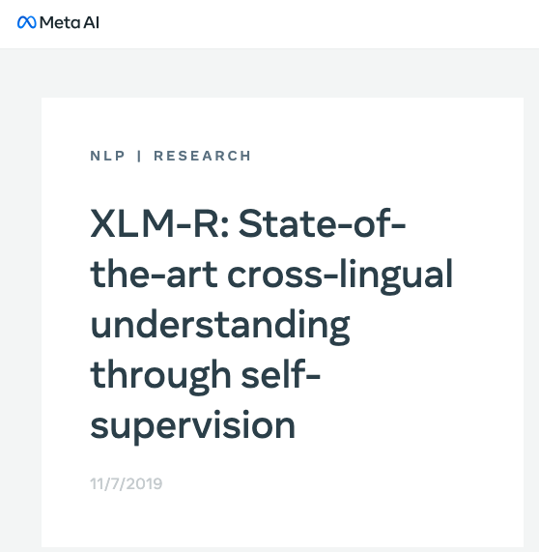
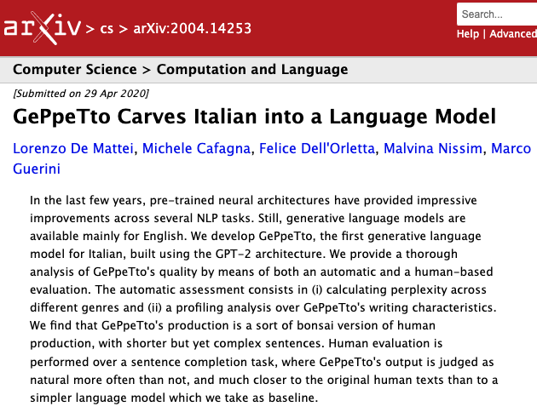
Multilingual and non-English NLP

Slide 18
Problems
Multilingual Models
Curse of multilinguality
Non-english trained from scratch
Unfeasible to train a new BERT/GPT for every language
More esoteric datasets only in English

Slide 19
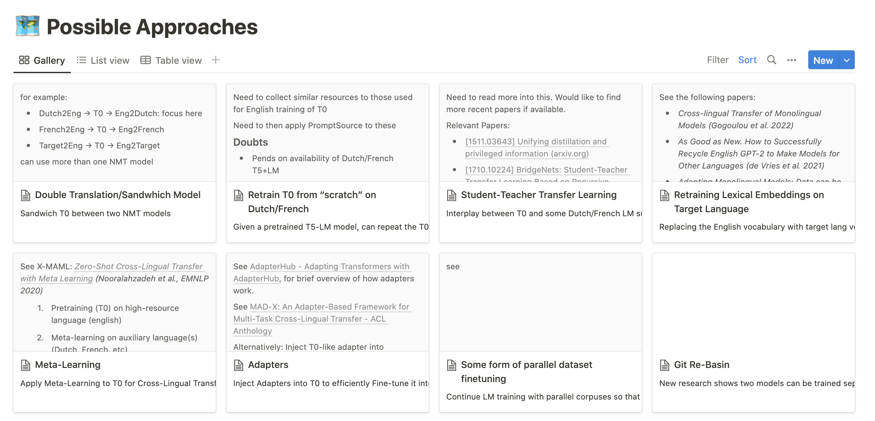

Slide 20
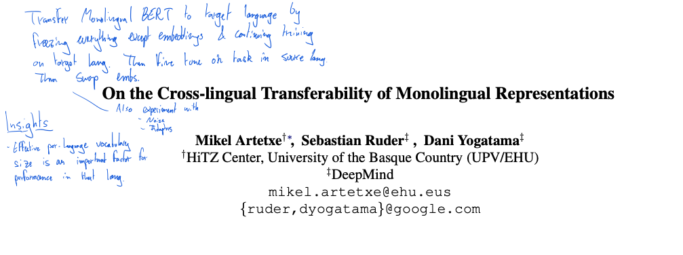
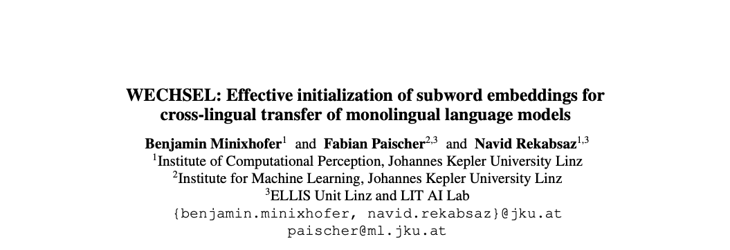
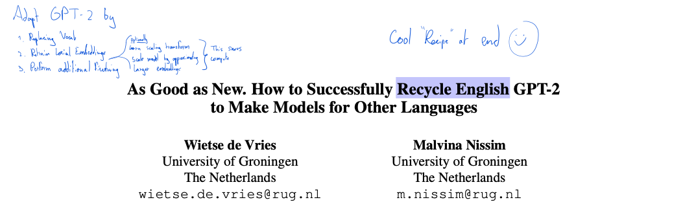
Cross-Lingual Adaptation of Monolingual Language Models

Slide 21
Questions
What if we evaluate adapted GPT2 models extrinsically?
Does this scale with larger GPT2 sizes?
Can this be directly applied to Fine-Tuned models, preserving Fine-tuning?

Slide 22
Our work
considers techniques for the efficient cross-lingual transfer of models fine-tuned on in-context learning (ICL).
Contributions
Show that WECHSEL scales to large GPT2 variant. We release German and French GPT2-large checkpoints.
Evaluate geWECHSELt models extrinsically on downstream tasks
Assess whether WECHSEL can be applied to fine-tuned models without causing catastrophic forgetting
Introduce the notion of “targeted distillation”, a form of post-hoc disentanglement leveraging vessel adapters

Slide 23
Method

Slide 24
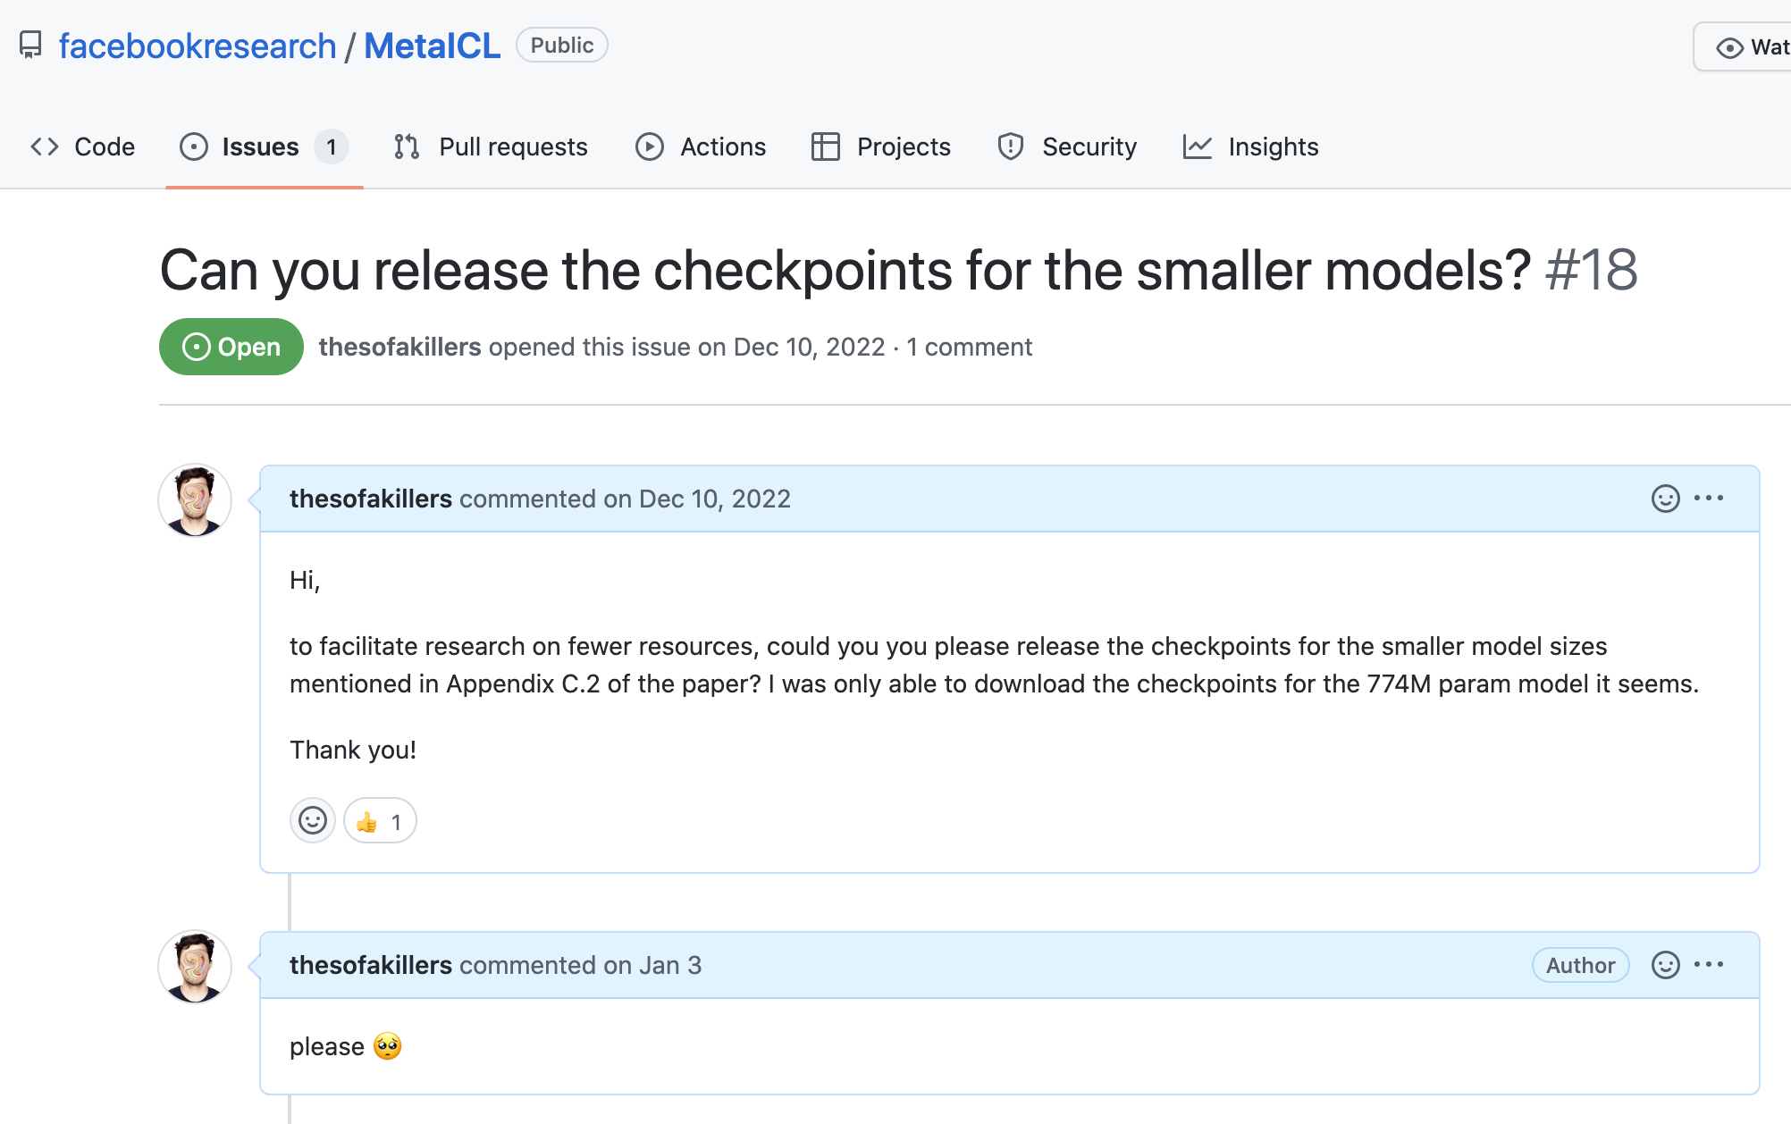
Experimental Setup

Slide 25
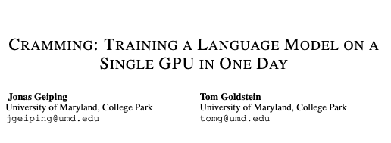
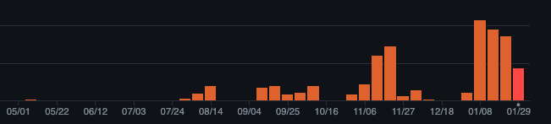
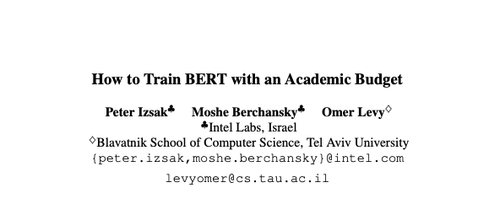
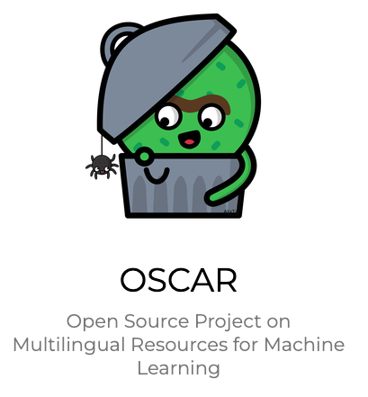
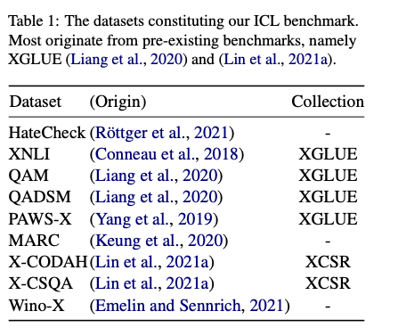
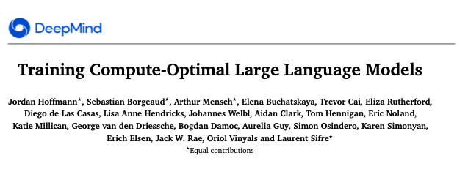
Experimental Setup

Slide 26
Results and Analysis
WECHSEL scales to larger models in terms of intrinsic evaluation
future work: check if this holds for converged models

Slide 27
Results and Analysis

Slide 28
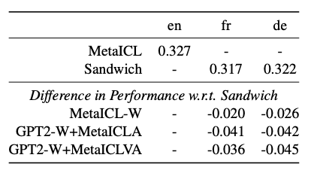
Results and Analysis
Sandwich performs roughly on par with MetaICL!
Fail to reproduce MetaICL performance from original paper
Proposed models underperform compared to Sandwich

Slide 29
Limitations
Preliminary nature
Larger compute scale
Hyperparameter sweeps
More in depth look at available Adapters necessary
More in depth look at PHoDiVA
Small-ish multi-task framework
Relies on translations, which can suffer from noise
Remains monolingual. Can we adapt a monolingual model to a new language and maintain the original one?
All the limitations of MetaICL are preserved
Only one seed tested ☹

Slide 30
Conclusion and Lessons Learned
WECHSEL scales to larger model sizes
But all our attempts at adapting fine-tuned ICL-capable models underperform compared to our Sandwich baseline.
Non-English NLP datasets are severely lacking.
Don’t over-read, start experimenting ASAP.
Engineering gets in the way
Think about evaluation early-on.
Try to think about the resources required early on.
“Small” models are bigger than you think

Slide 31
Thank you!

Slide 32
References
13.
Izsak, P., Berchansky, M. & Levy, O. How to Train BERT with an Academic Budget. Preprint at https://doi.org/10.48550/arXiv.2104.07705 (2021).
14.
Hoffmann, J. et al. Training Compute-Optimal Large Language Models. Preprint at https://doi.org/10.48550/arXiv.2203.15556 (2022).
15.
Gogoulou, E., Ekgren, A., Isbister, T. & Sahlgren, M. Cross-lingual Transfer of Monolingual Models. in Proceedings of the Thirteenth Language Resources and Evaluation Conference 948–955 (European Language Resources Association, 2022).
16.
Geiping, J. & Goldstein, T. Cramming: Training a Language Model on a Single GPU in One Day. Preprint at https://doi.org/10.48550/arXiv.2212.14034 (2022).
17.
Emelin, D. & Sennrich, R. Wino-X: Multilingual Winograd Schemas for Commonsense Reasoning and Coreference Resolution. in Proceedings of the 2021 Conference on Empirical Methods in Natural Language Processing 8517–8532 (Association for Computational Linguistics, 2021). doi:10.18653/v1/2021.emnlp-main.670.
(European Language Resources Association, 2022).
16.
Geiping, J. & Goldstein, T. Cramming: Training a Language Model on a Single GPU in One Day. Preprint at https://doi.org/10.48550/arXiv.2212.14034 (2022).
17.
Emelin, D. & Sennrich, R. Wino-X: Multilsingual Winograd Schemas for Commonsense Reasoning and Coreference Resolution. in Proceedings of the 2021 Conference on Empirical Methods in Natural Language Processing 8517–8532 (Association for Computational Linguistics, 2021). doi:10.18653/v1/2021.emnlp-main.670.
18.
de Vries, W. et al. BERTje: A Dutch BERT Model. Preprint at https://doi.org/10.48550/arXiv.1912.09582 (2019).
19.
de Vries, W. & Nissim, M. As Good as New. How to Successfully Recycle English GPT-2 to Make Models for Other Languages. in Findings of the Association for Computational Linguistics: ACL-IJCNLP 2021 836–846 (Association for Computational Linguistics, 2021). doi:10.18653/v1/2021.findings-acl.74.
20.
de Vries, W., Bartelds, M., Nissim, M. & Wieling, M. Adapting Monolingual Models: Data can be Scarce when Language Similarity is High. in Findings of the Association for Computational Linguistics: ACL-IJCNLP 2021 4901–4907 (Association for Computational Linguistics, 2021). doi:10.18653/v1/2021.findings-acl.433.
21.
De Mattei, L., Cafagna, M., Dell’Orletta, F., Nissim, M. & Guerini, M. GePpeTto Carves Italian into a Language Model. Preprint at https://doi.org/10.48550/arXiv.2004.14253 (2020).
22.
Conneau, A. et al. XNLI: Evaluating Cross-lingual Sentence Representations. arXiv:1809.05053 [cs] (2018).
23.
Conneau, A. et al. Unsupervised Cross-lingual Representation Learning at Scale. arXiv:1911.02116 [cs] (2020).
24.
Chung, H. W. et al. Scaling Instruction-Finetuned Language Models. Preprint at https://doi.org/10.48550/arXiv.2210.11416 (2022).
25.
Chan, B., Schweter, S. & Möller, T. German’s Next Language Model. in Proceedings of the 28th International Conference on Computational Linguistics 6788–6796 (International Committee on Computational Linguistics, 2020). doi:10.18653/v1/2020.coling-main.598.
26.
BigScience Workshop. BLOOM: A 176B-Parameter Open-Access Multilingual Language Model. Preprint at https://doi.org/10.48550/arXiv.2211.05100 (2022).
27.
Bach, S. H. et al. PromptSource: An Integrated Development Environment and Repository for Natural Language Prompts. arXiv:2202.01279 [cs] (2022).
1.
Yang, Y., Zhang, Y., Tar, C. & Baldridge, J. PAWS-X: A Cross-lingual Adversarial Dataset for Paraphrase Identification. in Proceedings of the 2019 Conference on Empirical Methods in Natural Language Processing and the 9th International Joint Conference on Natural Language Processing (EMNLP-IJCNLP) 3687–3692 (Association for Computational Linguistics, 2019). doi:10.18653/v1/D19-1382.
2.
Wei, J. et al. Finetuned Language Models are Zero-Shot Learners. in (2021).
3.
Röttger, P. et al. HateCheck: Functional Tests for Hate Speech Detection Models. in Proceedings of the 59th Annual Meeting of the Association for Computational Linguistics and the 11th International Joint Conference on Natural Language Processing (Volume 1: Long Papers) 41–58 (Association for Computational Linguistics, 2021). doi:10.18653/v1/2021.acl-long.4.
4.
Ouyang, L. et al. Training language models to follow instructions with human feedback. Preprint at https://doi.org/10.48550/arXiv.2203.02155 (2022).
5.
Ortiz Suárez, P. J., Romary, L. & Sagot, B. A Monolingual Approach to Contextualized Word Embeddings for Mid-Resource Languages. in Proceedings of the 58th Annual Meeting of the Association for Computational Linguistics 1703–1714 (Association for Computational Linguistics, 2020). doi:10.18653/v1/2020.acl-main.156.
6.
Minixhofer, B., Paischer, F. & Rekabsaz, N. WECHSEL: Effective initialization of subword embeddings for cross-lingual transfer of monolingual language models. in Proceedings of the 2022 Conference of the North American Chapter of the Association for Computational Linguistics: Human Language Technologies 3992–4006 (Association for Computational Linguistics, 2022). doi:10.18653/v1/2022.naacl-main.293.
7.
Min, S., Lewis, M., Zettlemoyer, L. & Hajishirzi, H. MetaICL: Learning to Learn In Context. in Proceedings of the 2022 Conference of the North American Chapter of the Association for Computational Linguistics: Human Language Technologies 2791–2809 (Association for Computational Linguistics, 2022). doi:10.18653/v1/2022.naacl-main.201.
8.
Martin, L. et al. CamemBERT: a Tasty French Language Model. in Proceedings of the 58th Annual Meeting of the Association for Computational Linguistics 7203–7219 (Association for Computational Linguistics, 2020). doi:10.18653/v1/2020.acl-main.645.
9.
Lin, B. Y., Lee, S., Qiao, X. & Ren, X. Common Sense Beyond English: Evaluating and Improving Multilingual Language Models for Commonsense Reasoning. in Proceedings of the 59th Annual Meeting of the Association for Computational Linguistics and the 11th International Joint Conference on Natural Language Processing (Volume 1: Long Papers) 1274–1287 (Association for Computational Linguistics, 2021). doi:10.18653/v1/2021.acl-long.102.
10.
Liang, Y. et al. XGLUE: A New Benchmark Datasetfor Cross-lingual Pre-training, Understanding and Generation. in Proceedings of the 2020 Conference on Empirical Methods in Natural Language Processing (EMNLP) 6008–6018 (Association for Computational Linguistics, 2020). doi:10.18653/v1/2020.emnlp-main.484.
11.
Lhoest, Q. et al. Datasets: A Community Library for Natural Language Processing. in Proceedings of the 2021 Conference on Empirical Methods in Natural Language Processing: System Demonstrations 175–184 (Association for Computational Linguistics, 2021). doi:10.18653/v1/2021.emnlp-demo.21.
12.
Keung, P., Lu, Y., Szarvas, G. & Smith, N. A. The Multilingual Amazon Reviews Corpus. in Proceedings of the 2020 Conference on Empirical Methods in Natural Language Processing (EMNLP) 4563–4568 (Association for Computational Linguistics, 2020). doi:10.18653/v1/2020.emnlp-main.369.

